Slide 1

Steep Turn

Slide 2
Housekeeping
60 minutes
Emergency exit, toilet, kitchen

Slide 3

Aim
The aim of this briefing is to teach the student techniques used to fly level and descending steep turns using 45$°$ and 60$°$ angle of bank.

Slide 4
Motivation
Steep turns is an exercise which is intended to improve your co-ordination and competency in handling an aeroplane at a steeper angles of bank.
Additionally, it will improve your confidence and be a benefit should the need to take evasive action arise.

Slide 5
Overview
Objectives
Revision
Definitions
Forces acting in a steep turn
Types of steep turns
Considerations
Application
Airmanship & TEM
Summary
Objectives – revisited

Slide 6
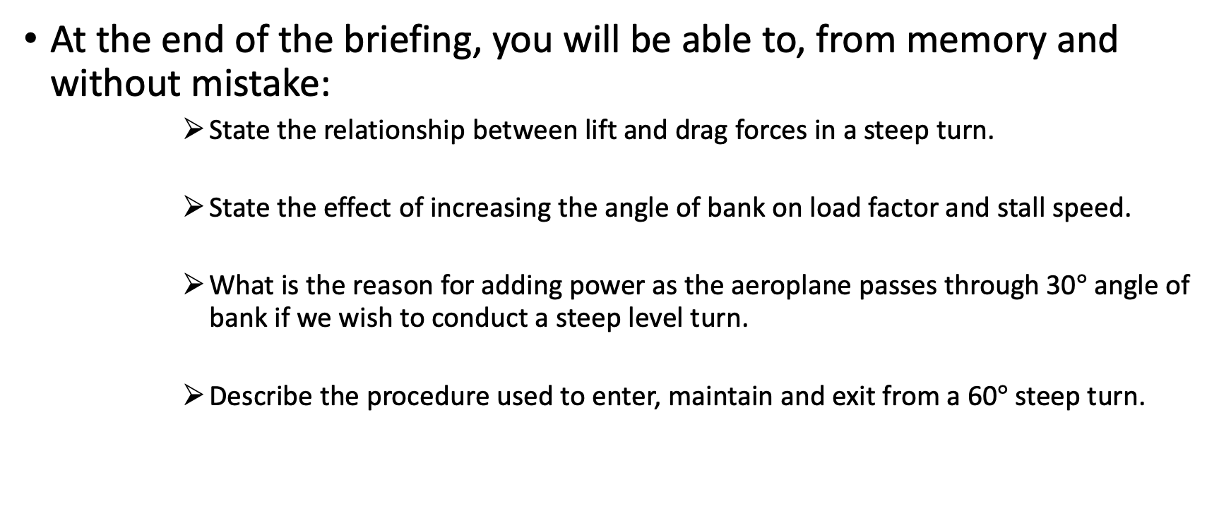
Objectives
At the end of the briefing, you will be able to, from memory and without mistake:
State the relationship between lift and drag forces in a steep turn.
State the effect of increasing the angle of bank on load factor and stall speed.
What is the reason for adding power as the aeroplane passes through 30$°$ angle of bank if we wish to conduct a steep level turn.
Describe the procedure used to enter, maintain and exit from a 60$°$ steep turn.

Slide 7
Revision
What the effect would be on the stall speed with an increase in angle of bank.
Explain the forces acting in a medium level turn.

Slide 8
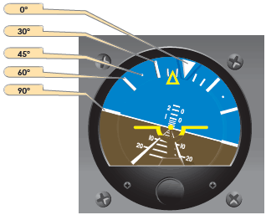
Definitions
Bank angle
The angle between an aeroplane’s lateral axis and the horizon.
Load factor
The ratio of lift to the weight of an aeroplane. The units in which load factor is expressed as is “g” i.e. G force.

Slide 9
Definitions
Rate of turn
The number of degrees of change per second.
Radius of turn
The distance between the aeroplane and the centre of the turn.

Slide 10
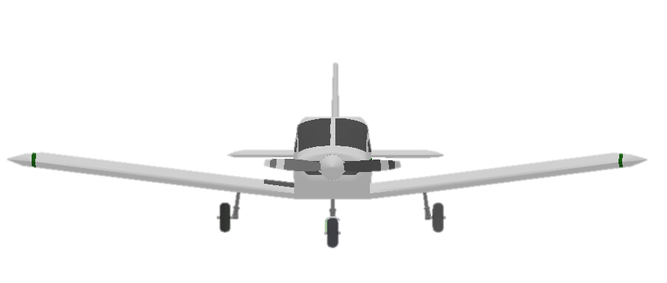
Forces acting in a steep turn
L
W

Slide 11
Forces acting in a steep turn
Vertical component Lift
L
Horizontal component lift
W
30°

Slide 12
Forces acting in a steep turn
Lift = 2 x Weight
Vertical component Lift
L
Horizontal component lift
W
60°(Steep turn >30°)

Slide 13

Forces acting in a steep turn
At 45$°$ AoB the induced drag is increased by 100%
At 60$°$ AoB the induced drag is increased by 300%
Need to use power to counteract the increase in drag.

Slide 14

Types of steep turns
Level steep turns
45$°$ and 60$°$ AoB (power to control airspeed)
Descending steep turns
45$°$ and 60$°$ AoB (airspeed is determined by AoB)

Slide 15
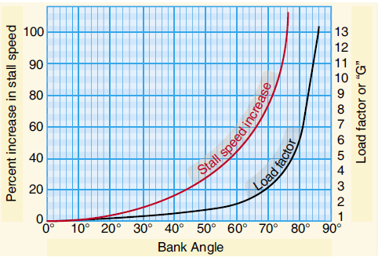

Considerations
Load Factor
Normal stall speed is 50 KIAS in clean configuration, the stalling speed IAS in a 60 $°$ AoB level turn, which has a normal ‘g’ load of 2, will be:
50 $×\sqrt{2}$ = 50 $×$ 1.414 = 70 KIAS

Slide 16
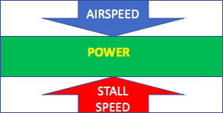
Considerations
Stall margin
The power is increased to combat the increased drag to maintain a margin over the stall speed. This can be referred to as a power sandwich.

Slide 17
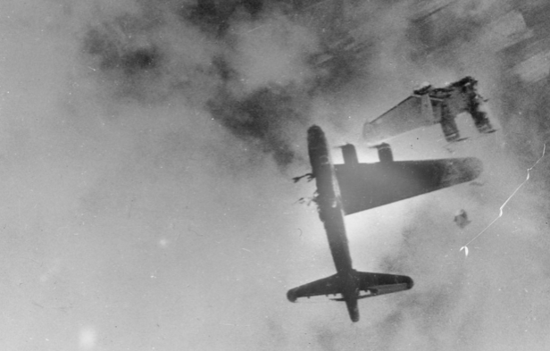
Considerations
Structural limitation
PA-28 approved in both normal(+3.8, -0.0) and utility(+4.4, -0.0) categories.
Must know structural limits as we can overstress the airframe by exceeding the maximum allowable load factor.
Notes:
As we increase AoB, we increase lift & increase load factor

Slide 18
Considerations
Physiological effects
During steep turns the effort required by your heart to pump your blood to your brain increases as the load factor or apparent weight increases.
The heart pumps faster when the brain senses a decrease in oxygen levels, however there is a time delay and you may experience grey/black out or even GLOC.

Slide 19
Considerations
Grey-out
Usually begins with peripheral vision turning grey (tunnel vision)
The pilot is fully conscious and still able to fly the aeroplane
This normally occurs above 3.5g
Black-out
Field of view turns black
The pilot cannot see however remains conscious
This normally occurs above 5g (higher than limit load factor for aeroplane)
GLOC (G-induced Loss Of Consciousness)
Occurs at higher G loading (7g) and results in the pilot losing consciousness
It is possible to have decreased tolerance to G loadings if the pilot had heat stress, hypoxia, low blood sugar levels

Slide 20
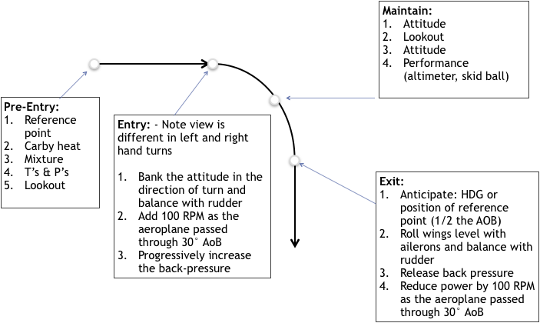

Application
45$°$ steep turn

Slide 21


Application
60$°$ steep turn

Slide 22
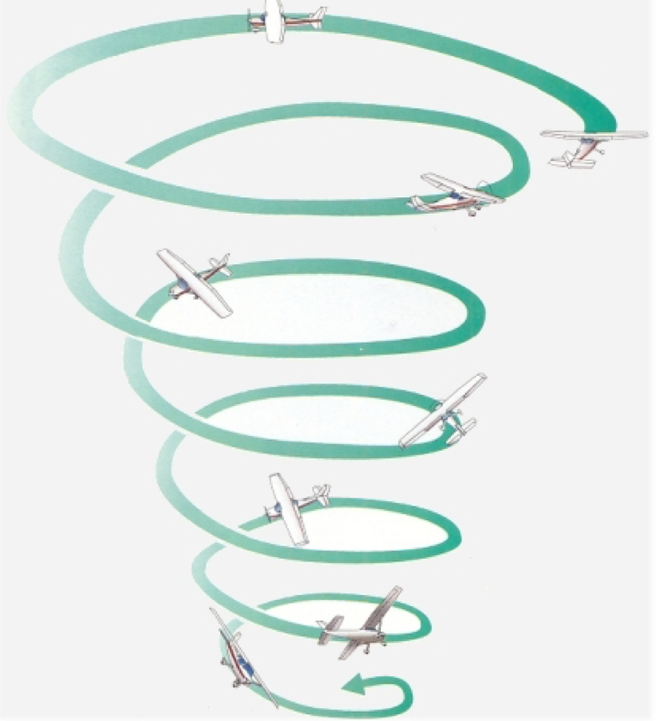
Application
Spiral dive
May occur if a steep turn is executed incorrectly (i.e. insufficient back-pressure or over-banking)
Symptoms:
Low nose attitude
High and increasing airspeed
High and increasing rate of turn
High and increasing G-force

Slide 23
Application
Spiral dive recovery
Throttle idle
Roll wings level and balance with rudder
Gently ease out of dive
As IAS reduces and nose passes through the horizon, add full power and climb at Vy

Slide 24
Airmanship
Lookout
ALAP throughout the turn
Smooth but firm control input

Slide 25
Threat and error management
Threat | Error | Management | UAS
Traffic | Poor lookout and Situational awareness | Good lookout ALAP
High G manoeuvre | Insufficient speed on entry |  | Stall
Air proximity event
Maintain speed
Use power

Slide 26
Summary
Forces acting in a steep turn
Structural limitations and physiological effects
Steep turn and spiral dive

Slide 27
Objectives – revisited
State the relationship between lift and drag forces in a steep turn.
State the effect of increasing the angle of bank on load factor and stall speed.
What is the reason for adding power as the aeroplane passes through 30° angle of bank if we wish to conduct a steep level turn.
Describe the procedure used to enter, maintain and exit from a 60° steep turn.

Slide 28

The End

